Slide 1

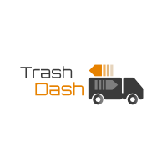
Smart City Smart Solutions
Trash Pickup OnDemand

Slide 2
Trash Dash Opportunity
Market Size
Over US$ 60B, 55% is solid waste collection
Competition
Technology start-ups
Customer Profile
Trash collection companies
Individual customers seeking personalized collection requirements
Suburb
Infrequent or low trash use
Large, specialty item pick-up such as appliances, furniture etc.
Business Model
Subscription fee
Single use fee
Team
Lynne
Jack
King
Jonathan
Purvee
Advisor
Pete

Slide 3
Product Demo

